Slide 1


Aggregate Programming
Jacob Beal
10th Swarm Intelligence Conf.
September 2016

Slide 2
A generative approach to safety
Restrict your development environment…
… to contain only resilient distributed systems.

Slide 3
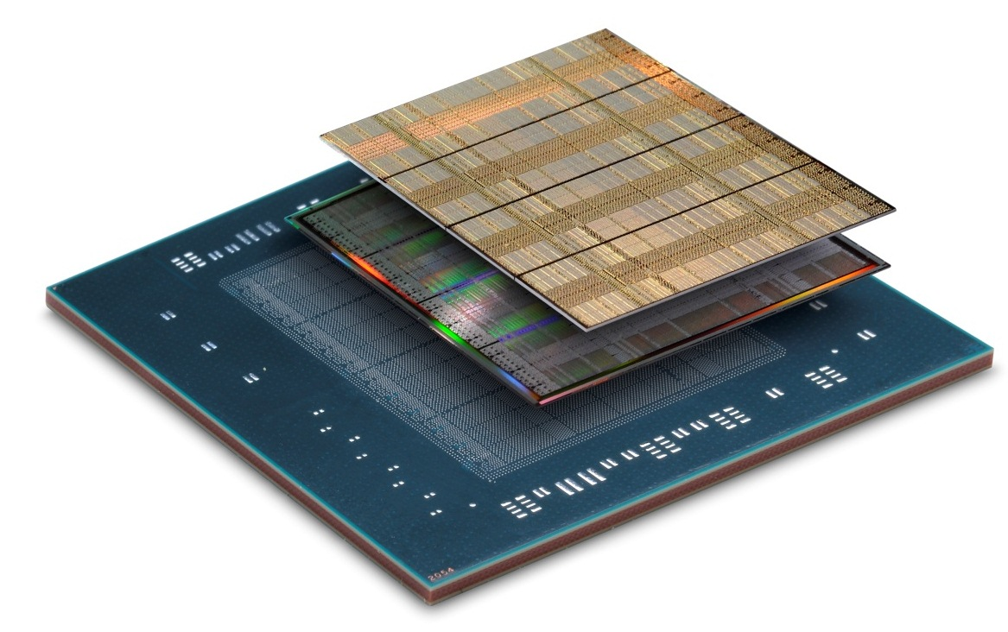
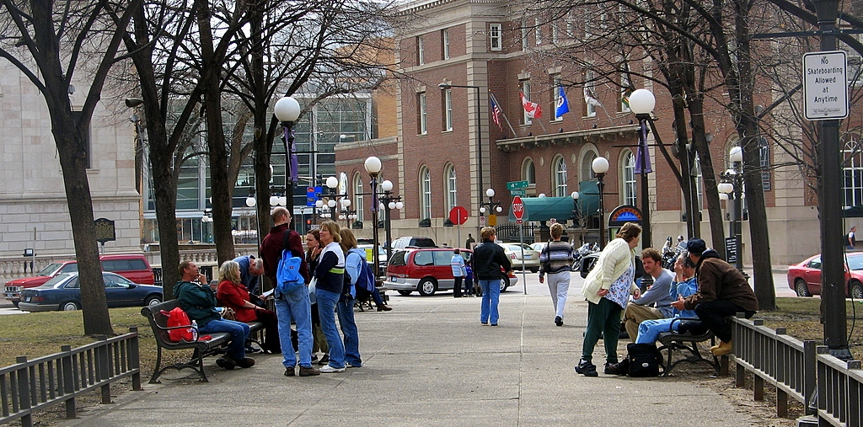
Dealing with challenging platforms
Emerging Computational Platforms
Computational Field
Programming Models
Inherently Resilient
Distributed Systems
device
neighborhood
Pay a little efficiency, get a lot of programmability and resilience

Slide 4
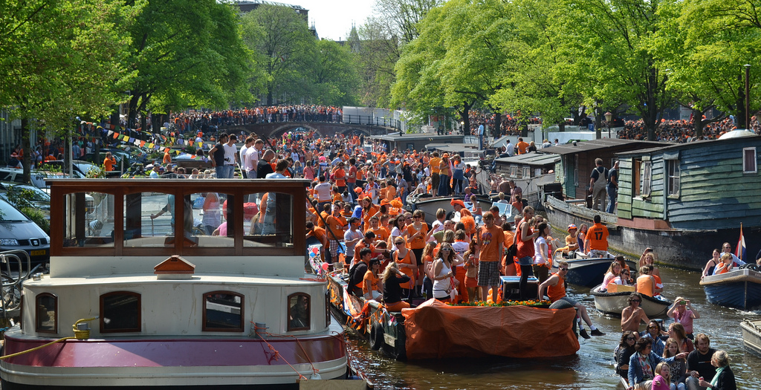
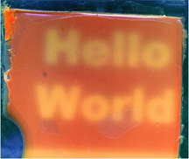
Fundamentally different models
Isolate Systems
Extremely High FLOPs
High Dispersion
Moderate FLOPs
High Resolution Sense/Act
Abysmal FLOPs
How can we program aggregates adaptively & efficiently?
Are there commonalities that cross substrates?
Notes:
(e.g., biosensors talk bootstrap off cheap wireless talks to talk to cloud computation

Slide 5
Example: Services for Mass Events

Slide 6
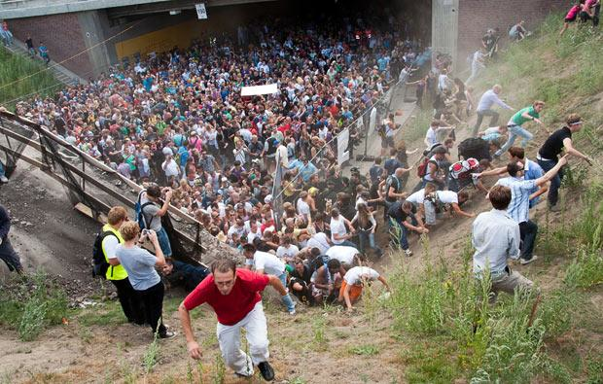
Example: Managing Crowd Danger
Notes:
Love Parade disaster: electronic music festival in Duisberg, Germany in 2010. Many more people came then expected (possibly as many as 1.4 million to an old freight stations holding a max of 250K), and a mass panic caused 21 deaths and 510 injuries.

Slide 7

Device-Centric Programming
Dispersal Advice
Congestion-Aware Navigation
Dangerous Density Warning
Crowd Estimation
Explicit design of adaptation and communication
Complex per-device multi-service application
Intractable to ensure correct behavior

Slide 8
Aggregate Programming
Dispersal Advice
Congestion-Aware Navigation
Dangerous Density Warning
Crowd Estimation
Implicit adaptation and communication
Code each collective service independently
Compose via scope and information flow

Slide 9

Aggregate Programming

Slide 10
Aggregate Programming Stack

Slide 11
Example: Mesh-Network Cell Phones

Slide 12
Geometric Program: Channel
Source
Desti-
nation
(cf. Butera)

Slide 13
Computing with fields
source
destination
width
distance-to
distance-to
distance
10
37
+
dilate
<=
Notes:
Functional computation on time-dependent fields

Slide 14
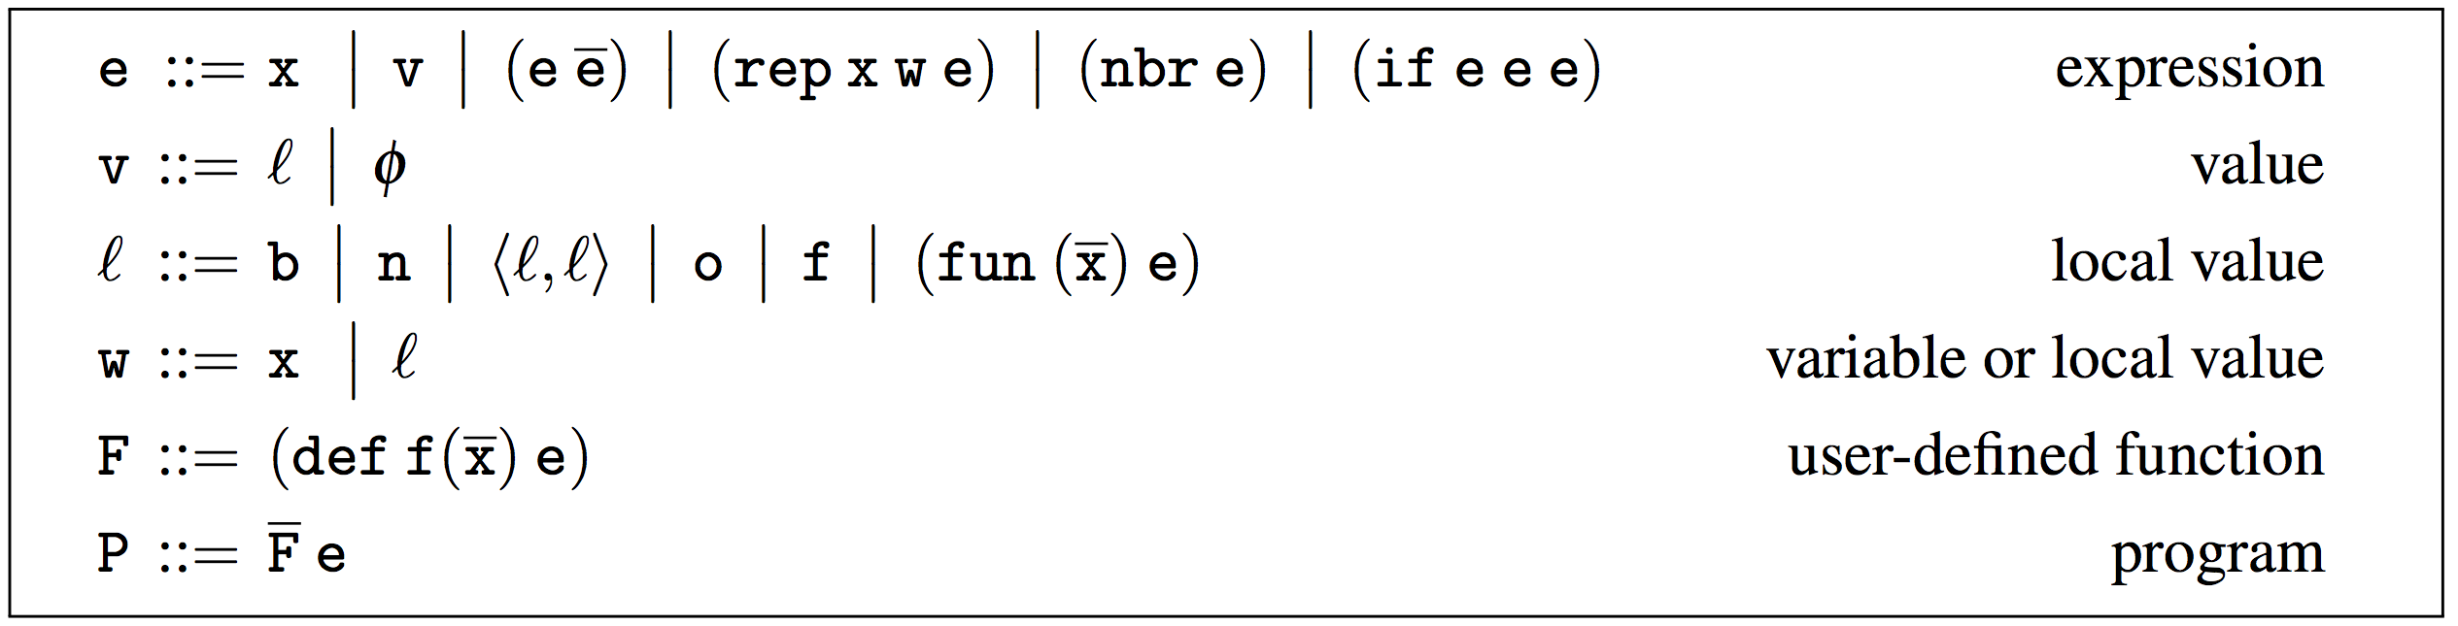
(Higher Order) Field Calculus
Literal Value
Variable
Local Ops
State
Communication
Domain Change
Abstract & Call
Functions
[Viroli et al., ‘13, Damiani et al., ‘15]

Slide 15
Field Calculus is Space-Time Universal
Space-time Universal = arbitrarily good approximation of any causal, finitely-approximable computation
Specification:
Acausal
Non-approximable
[Beal, ’10; Beal et al., SCW 14]

Slide 16
Instantiation: Proto
(def gradient (src) ...)
(def distance (src dst) ...)
(def dilate (src n)
(<= (gradient src) n))
(def channel (src dst width)
(let* ((d (distance src dst))
(trail (<= (+ (gradient src)
(gradient dst))
d)))
(dilate trail width)))
evaluation
global to local
compilation
Global Local Discrete
platform
specificity &
optimization
device
neighborhood
discrete
approximation
Device
Kernel
http://proto.bbn.com/
[Beal & Bachrach, '06]

Slide 17
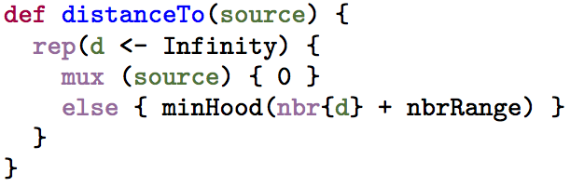
Instantiation: Protelis
Java-hosted & integrated
Java-like syntax
Eclipse support
Architecture:
[Pianini, Viroli, & Beal, SAC ‘15]

Slide 18
Using Protelis in your projects
http://protelis.org

Slide 19
Aggregate Programming Stack

Slide 20
Example: Managing Crowd Danger
Notes:
Love Parade disaster: electronic music festival in Duisberg, Germany in 2010. Many more people came then expected (possibly as many as 1.4 million to an old freight stations holding a max of 250K), and a mass panic caused 21 deaths and 510 injuries.

Slide 21
Example of a complex service
(def evacuate (zone coordinator alert)
(let ((alerted
(if zone
(broadcast coordinator
(collect-region
(distance-to commander)
alert))
0))))
(* alerted
(follow-gradient
(distance-to (not zone))))))

Slide 22
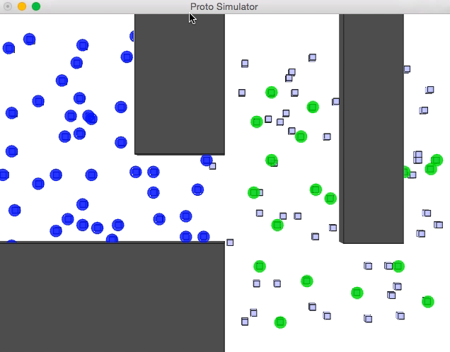
Self-stabilization is hard to get right
Naïve geometry: when stationary, fine…

Slide 23
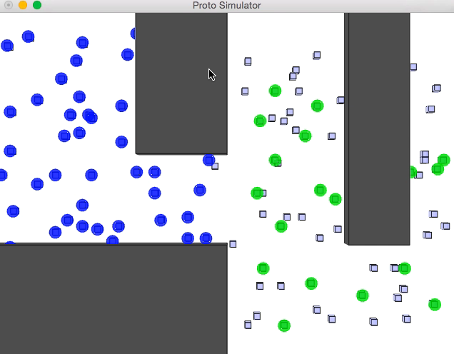
Self-stabilization is hard to get right
… but doesn’t correct properly for change.

Slide 24
Self-Stabilizing Building Blocks
G
Information spreading
C
Information collection
T
Short-term memory
4
3
1
7
1
3
3
0
2
Resilience by construction: all programs from these building blocks are also self-stabilizing!

Slide 25
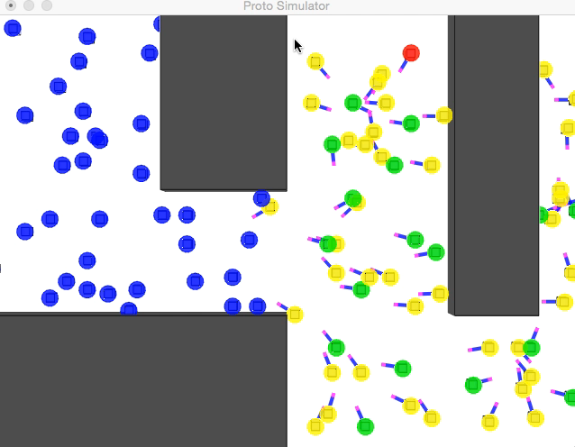
All combinations are self-stabilizing!
Now program rapidly converges following changes

Slide 26
Aggregate Programming Stack

Slide 27
Applying building blocks:
Example API algorithms from building blocks:
distance-to (source) max-likelihood (source p)
broadcast (source value) path-forecast (source obstacle)
summarize (sink accumulate local null) average (sink value)
integral (sink value) region-max (sink value)
timer (length) limited-memory (value timeout)
random-voronoi (grain metric) group-size (region)
broadcast-region (region source value) recent-event (event timeout)
distance-avoiding-obstacles (source obstacles)
Since based on these building blocks, all programs built this way are self-stabilizing!

Slide 28
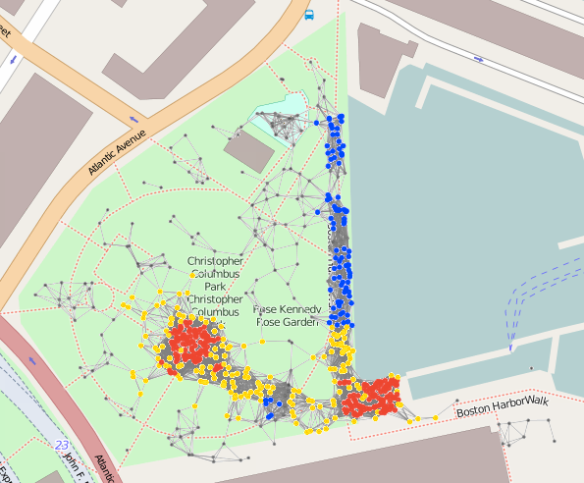
Complex Example: Crowd Management
(def crowd-tracking (p)
;; Consider only Fruin LoS E or F within last minute
(if (recently-true (> (density-est p) 1.08) 60)
;; Break into randomized ‘‘cells’’ and estimate danger of each
(+ 1 (dangerous-density (sparse-partition 30) p))
0))
(def recently-true (state memory-time)
;; Make sure first state is false, not true...
(rt-sub (not (T 1 1)) state memory-time))
(def rt-sub (started s m)
(if state 1 (limited-memory s m)))
(def dangerous-density (partition p)
;; Only dangerous if above critical density threshold...
(and
(> (average partition (density-est p)) 2.17)
;; ... and also involving many people.
(> (summarize partition + (/ 1 p) 0) 300)))
(def crowd-warning (p range)
(> (distance-to (= (crowd-tracking p) 2))
range)
(def safe-navigation (destination p)
(distance-avoiding-obstacles
destination (crowd-warning p)))
18 lines non-whitespace code
10 library calls (21 ops)
IF: 3 G: 11 C: 4 T: 3

Slide 29
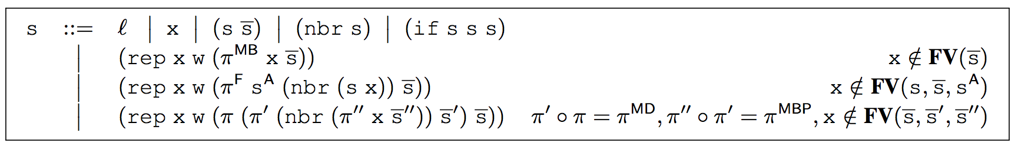
Generalization: Self-Stabilizing Calculus
Restrict field calculus by replacing e with s:
T
C
G

Slide 30
Self-Stabilization → Substitution
Given functions λ,λ′ with same type, λ is substitutable for λ′ iff for any self-stabilising list of expressions e, (λ e) always self-stabilises to the same value as (λ′ e).

Slide 31
Optimization of Dynamics
[Viroli, Beal, Damiani & Pianini, SASO ‘15]

Slide 32
Optimization Example: Crowd Alert
Naïve algorithm: when stationary, fine…

Slide 33
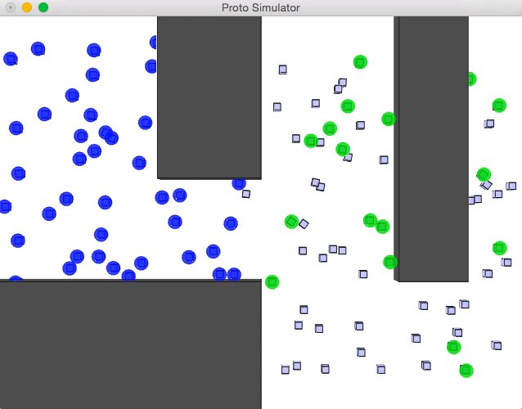
Optimization Example: Crowd Alert
… but dynamics can’t keep up with fast mobility.

Slide 34
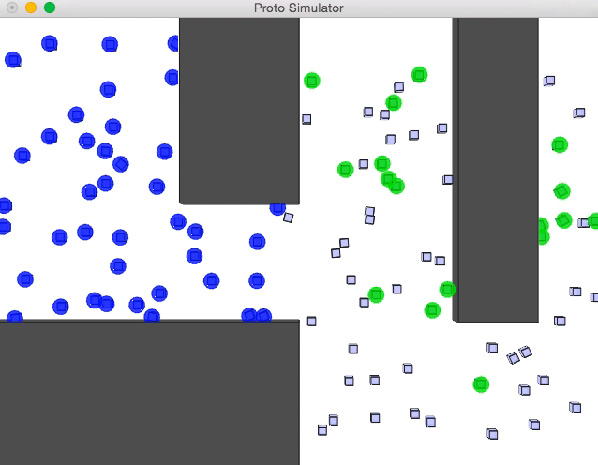
Optimization Example: Crowd Alert
Optimized dynamics, however, work well.

Slide 35
Aggregate Programming Stack

Slide 36
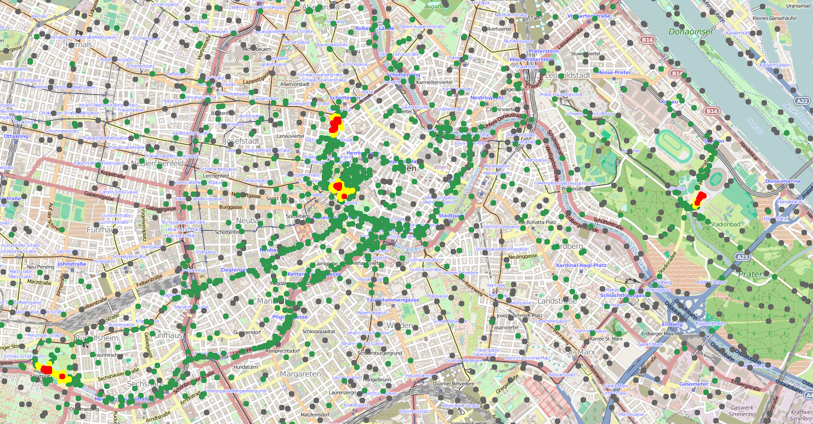
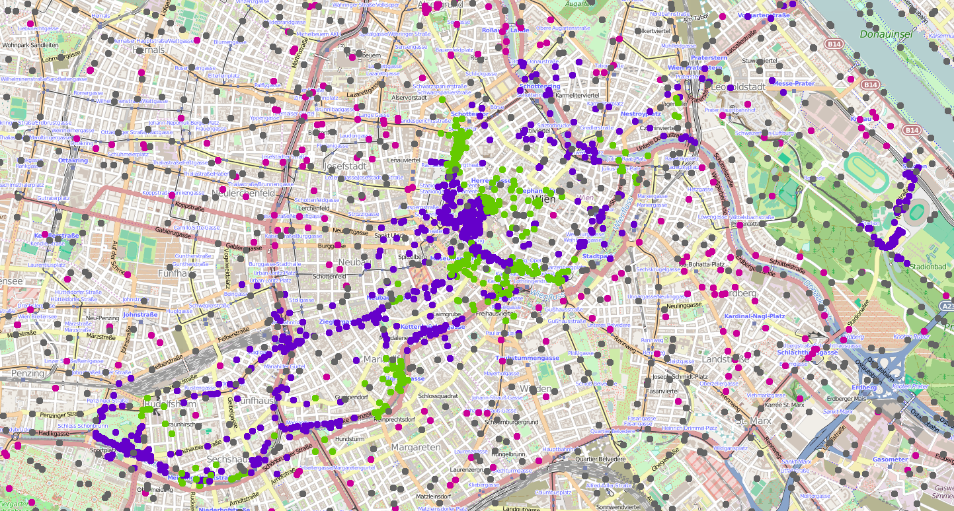
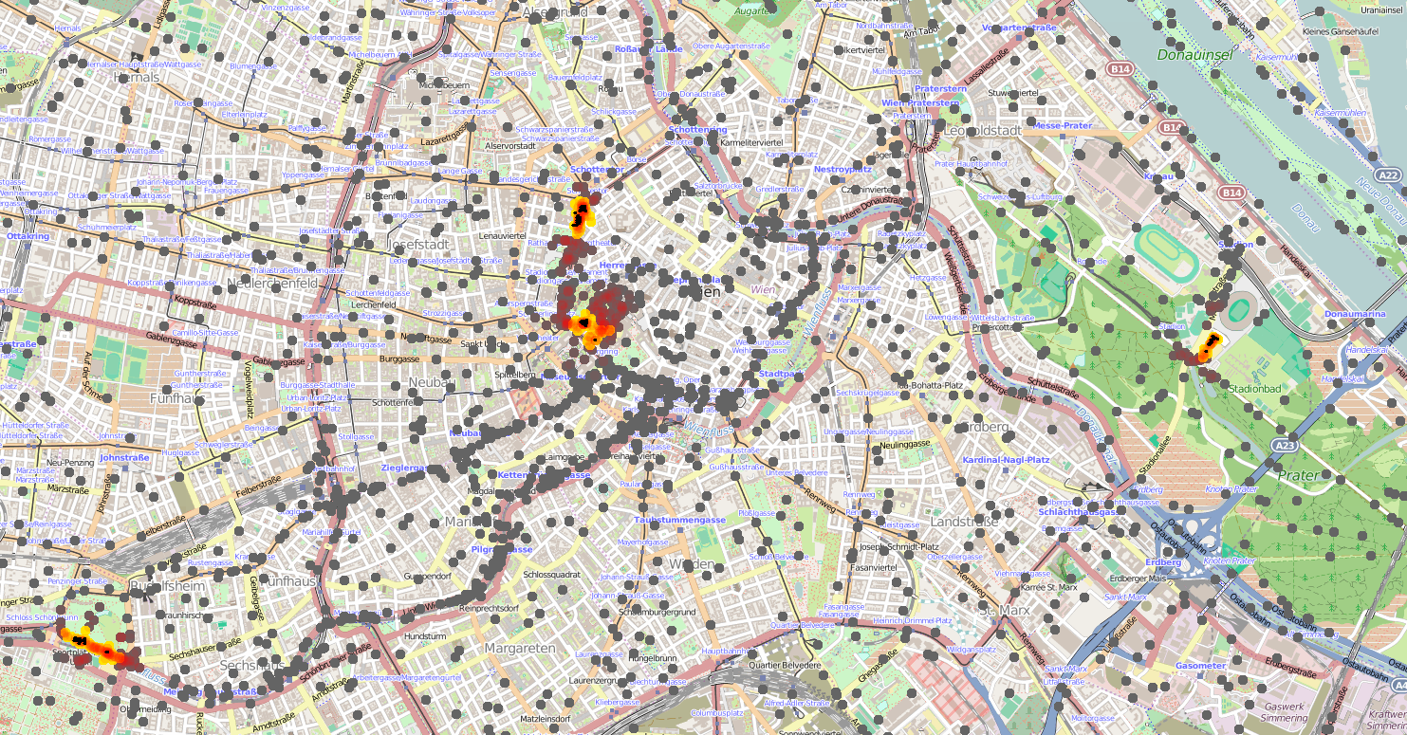
Crowd Safety Services
^{def dangerousDensity(p, r) {}
let mr = managementRegions(r*2, () -> { nbrRange });
let danger = average(mr, densityEst(p, r)) > 2.17 &&
summarize(mr, sum, 1 / p, 0) > 300;
if(danger) { high } else { low }
}
^{def crowdTracking(p, r, t) {}
let crowdRgn = recentTrue(densityEst(p, r)>1.08, t);
if(crowdRgn) { dangerousDensity(p, r) } else { none };
}
def crowdWarning(p, r, warn, t) {
distanceTo(crowdTracking(p,r,t) == high) < warn
}
Dissemination of new versions
Pre-emptive modulation of priorities

Slide 37
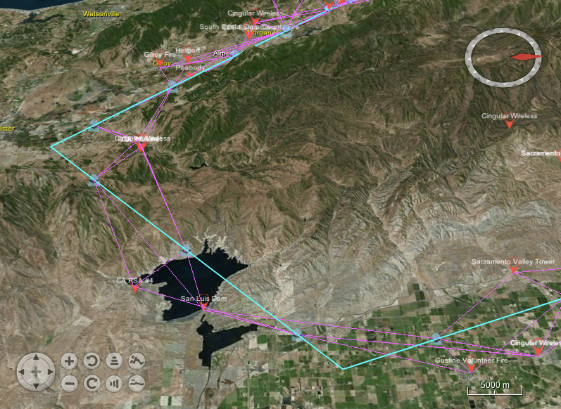
Opportunistic Airborne Sensor Sharing
GIS-integrated adaptive mission planning
Highly effective sharing
Low computational cost
[Beal, Usbeck, Loyall & Metzler, in prep]

Slide 38
Dependency-Directed Recovery
Dramatically better recovery time
Identify & shut down
affected services
Non-dependent
services still run
Fewer services disrupted
[Clark, Beal, & Pal, SASO ‘15]

Slide 39
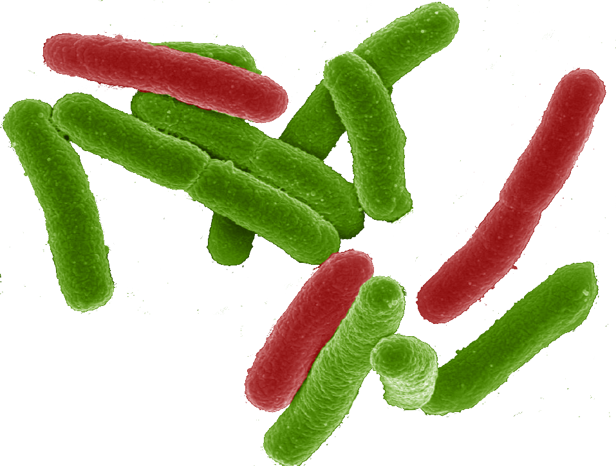

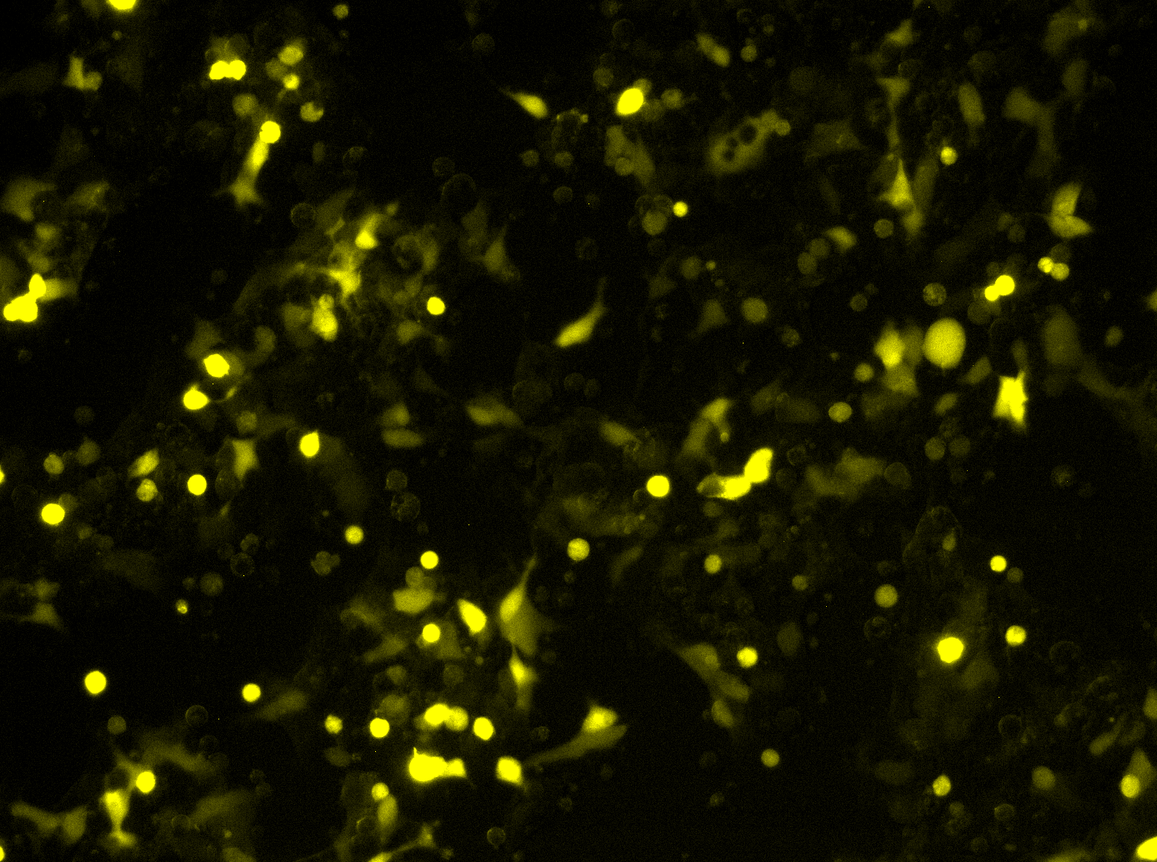

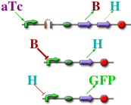
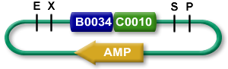
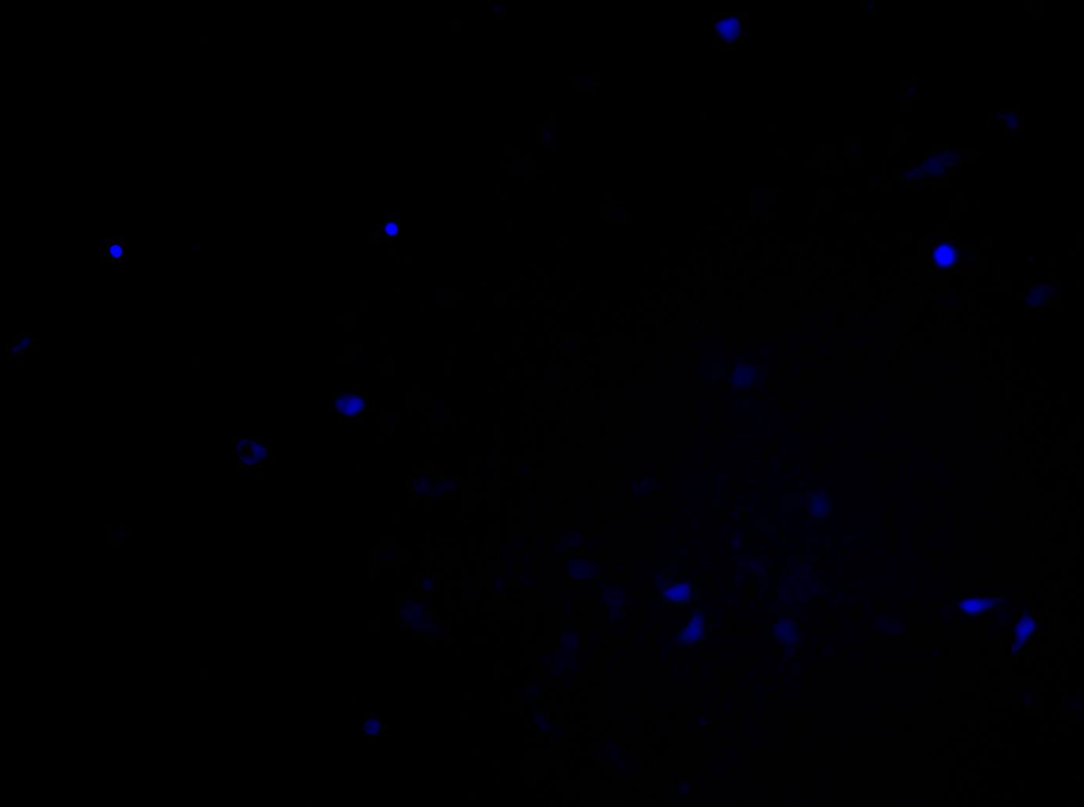
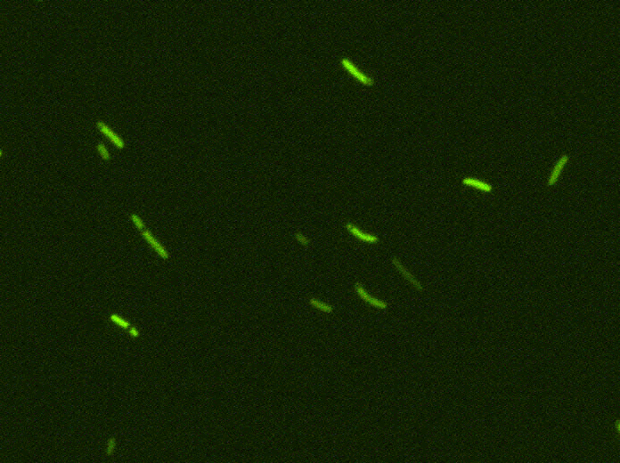
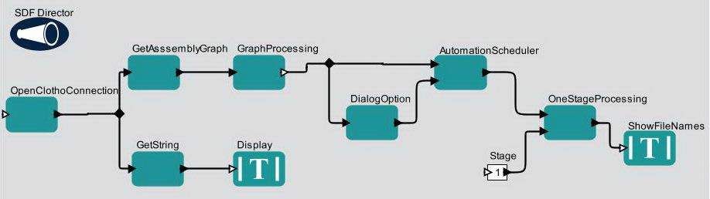
Engineering Biological Systems
(def simple-sensor-actuator ()
(let ((x (test-sensor)))
(debug-1 x)
(debug-2 (not x))))
If detect explosives:
emit signal
If signal > threshold:
glow red
Uninduced
Uninduced
Induced
Induced
Mammalian Target
E. coli Target
[Beal et al., 2012]

Slide 40
Summary: Aggregate Methodology
restrict

Slide 41
Summary
Major technological trends are all driving towards a world filled with distributed systems
Aggregate programming aims at rapid and reliable engineering of complex distributed systems
Field calculus provides a universal theoretical foundation for aggregate programming
Resilient systems design can be simplified by an emerging self-organization toolbox
Functional composition allows modulation, predictable convergence

Slide 42





Acknowledgements
Shane Clark
Partha Pal
Kyle Usbeck
Mirko Viroli
Danilo Pianini
Soura Dasgupta
Raghu Mudumbai
Amy Kumar
Ferruccio Damiani

